Slide 1
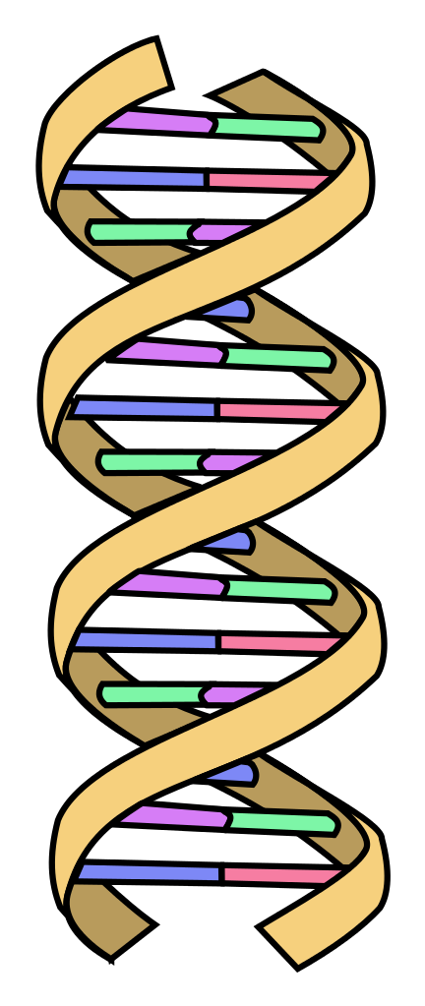
CRISPR
1
LECTURE SECTION: CHRISTIAN ANTHROPOLOGY, HUMAN RIGHTS AND DUTIES

Slide 2
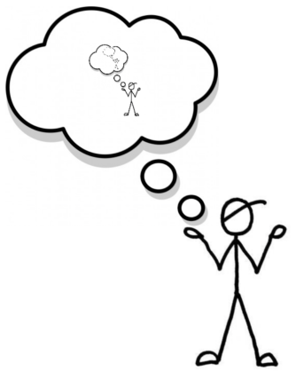
What makes you... you?
2

Slide 3

Why a proper anthropology is important?
3
You have to know what you are dealing with in order to make judgement about how that being should live the good life.
If you know what a being is you can make judgements about his/her rights and obligations toward others
Christian anthropology informs judgements about moral life and thus informs us of our obligations and guides us toward proper action, especially (in this case) as regard CRISPR technology.

Slide 4

What is Christian Anthropology?
4
The Study of Man from a Christian Perspective!
In light of divine revelation…
1. What are we?
2. Where do we come from?
3. Where are we going?
Who are we if we are not theists?
How does that impact our existence?
We want the best definition for who we are. The definition which actually leads to the good life.

Slide 5

Homework Review
5
Philosophical and religious errors about man, lead to errors about morality
“At the heart of liberty is the right to define one’s own concept of existence, of meaning, of the universe, and of the mystery of human life.”– PP
1. Man is totally determined by his environment- He cannot be held responsible for the choices he makes (philosophical determinism)
4. We cannot do anything righteous– we are “snow-covered dung”– nothing we do can separate us from God.
5. The spiritual aspect of man is primary, physical things are unimportant.
2. Man is just like any other animal.
3. Man is purely biological material.

Slide 6

Christian Anthropology Seeks to Highlight Human Dignity
6
Inestimable worth/value VS Estimable Worth
Created in the image and likeness of God
If our dignity is inestimable then we protect against all possible abuses
If our dignity is estimable or measurable we create or allow possible abuses

Slide 7
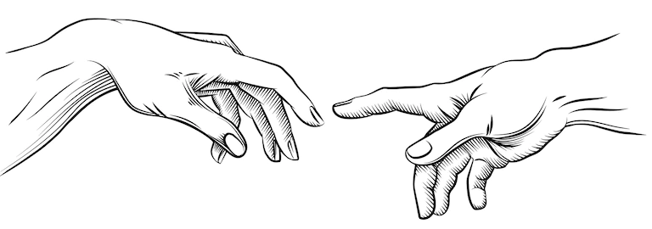
God Created US
7
He designed us, made us, knows our true good, knows what will lead to our Happiness.
Sin is rebellion of the creature from the creator: we were made to do things which unite us more closely to the source of our being. Yet we do things which indicate that we know what is best for ourselves.
Sin: missing the mark—that is, not aligning ourselves with an end proper to our nature.

Slide 8

God Created man a religious being…
8
So that by nature he seeks out God and is meant to enter into communion with God.
Re (again) Ligare (to bind, to tie)
God calls us to Him from our creation.
We are religious by nature– “and our hearts are restless until they rest in you!”
We were created by God FOR God.
This hole in our hearts is evident in all cultures.

Slide 9
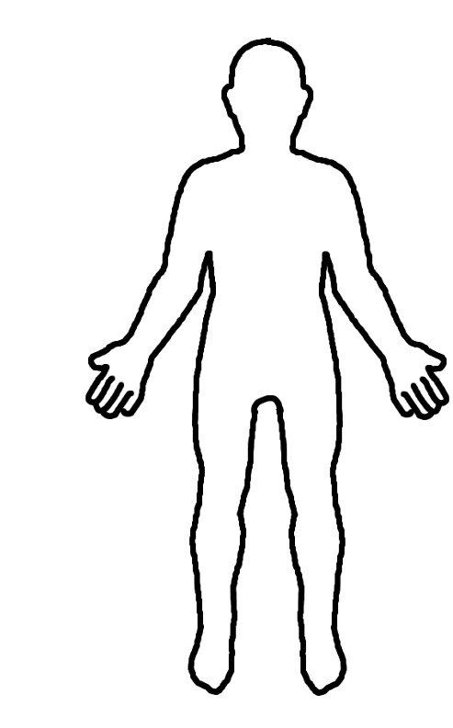

Man is a hylomorphic being
9
Composed of Body (material reality) and Soul (immaterial reality)
Genesis Dust and God Breath (Gen 2:7)
We are at once spiritual and corporeal
Hylomorphism (Hule: matter) & (Morphe: form, figure, shape).
2 causes (form and matter) which form 1 nature
Our soul is the form which informs the matter– it is because of the soul that the body (matter) becomes a living human body.
Not two natures (body and soul) but two united causes of 1 nature. Our body and soul are the cause of our nature.
Body + Soul = Person (that’s you!)

Slide 10

Man is the summit of Creation
10
Master of the universe– “God created everything for man, but man in turn was created to serve and love God and to offer all creation back to him.”
The rest of creation was made for man who is placed as steward over it.
Man is called to develop it and return it to God.
We are called to engage in all aspects of culture.
CCC 358

Slide 11
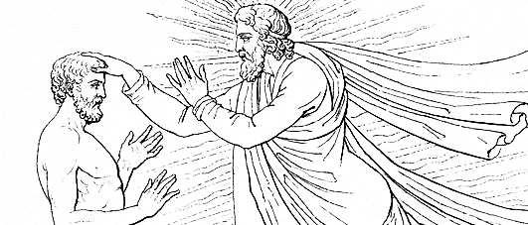
Man is the Imago Dei
11
All creatures are created in the likeness of God, but man is uniquely created in the image of God.
Image= Denotes a kind of reproduction of something
This means that the most fundamental aspect of Christian Social Teachings that man has DIGNITY– inestimable value or worth.
Image of God = inestimable worth
deification of man through unity to God.
God is Rational and has Will: He is a being who knows the Truth and Wills the Good.
Our personhood is another way of saying we are created in his image. “An individual substance of rational nature.”

Slide 12
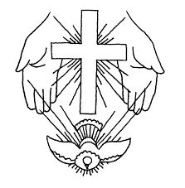
Imago Dei
12
God is an eternal relationship
Man only images Him then in a relational way.
“We must look upon them as persons who are called, together with us, to be members of the Body of Christ with whom we shall one day sit at table with Abraham, Isaac, and Jacob, and with Christ himself, as their brother and sisters, as the brothers and sisters of Christ, and as the children of God.” (Pope Benedict XVI)

Slide 13
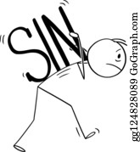
Man is in a Fallen Condition
13
1. Loss of Sanctifying Grace
2. Loss of Original Holiness
3. Loss of Original Justice
2. Body is not subject to soul
3. Creation is not subject to man
3. Darkened Intellect (ignorance)
4. Weakened Will
5. Disordered Appetites
6. Subject to the dominion of the devil

Slide 14
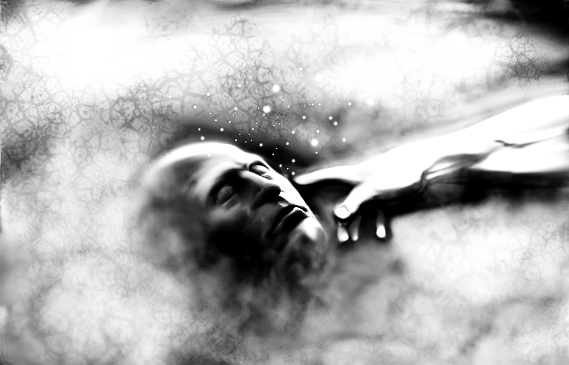
Jesus = Perfect Image
14
Our Model and Redeemer
He shows us what it means to be a human person.
Savior and redeemer who has merited the grace we need to overcome sin and follow Him.
We are called to God in lifelong transformation.

Slide 15
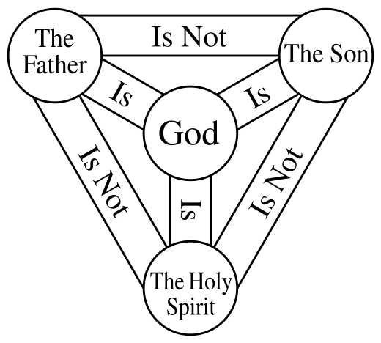
Man’s Final End is God
15

Slide 16
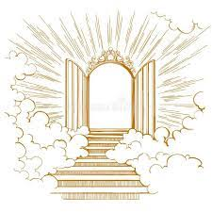


Man’s Happiness Depends upon attaining this final end.
16

Slide 17
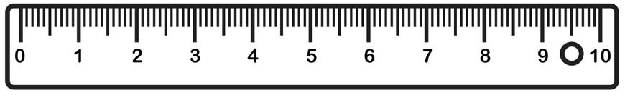
Human Nature as a measure
17
Natural Law is man's participation in the Divine Law
We judge the natural law–which tells us those things which are in and of themselves good or bad, by human nature.
We realize our human nature by doing the things which fully realize/actualize/perfect it and make us happy or even absolutely Happy (in Heaven).
The natural law then is nothing more or less than the guide to happiness.
It is the only way we can know how an act is morally good or bad– by which we mean whether it moves us or does not move us toward our shared ultimate end.
This human nature then is our Norm of Morality. It is also revelatory of a natural law.

Slide 18

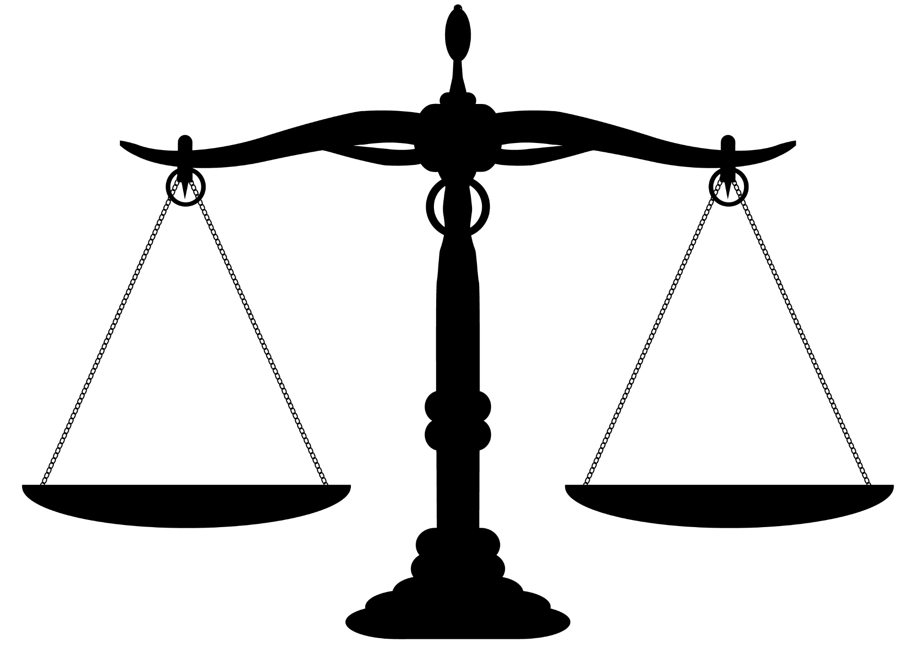
Rights and Duties
18
The right refers to the moral power to do, to hold, or to exact something. I have a right to exercise free speech.
All rights come from laws
* Natural rights come from natural law
* Positive (created) rights come from positive (created) law
Rights
Duties

Slide 19

What if no natural law exists?
19
If law only comes from the State:
The state has no right to exist, so how can it grant rights?
In only from a Contract:
A contract has no right to exist, so how can it guarantee anything?
Contracts are not binding if they guarantee something evil.
If law is generated via Equal freedom for all:
Then rights and morality are not connected. Basically all men can do what they want—so you are not obliged to do what he says and he doesn’t have to do what you say—everyone is equally free.
If it comes from Custom
Then evil customs can create rights
Then no natural rights exist

Slide 20

But it seems natural rights do exist
20
If rights do exist, then duties exist.
These are based upon our understanding of what it means to be human
If we are of inestimable worth then it would seem that we are obligated to the most just action.
That must include the unborn (who are human) and everyone else with whom we have relationship.

Slide 21

And so...
21
We deduce rights from natural law. A legitimate authority (parents, teachers, elected officials) can enhance those rights, but the rights themselves can only come from the natural law. The natural law is our participation in the divine law. This means that we cannot choose to change it.

Slide 22



What are those natural rights?
22
By the fact that we are human persons we have these rights.
Life—By the fact that you are alive, we all have the duty to not take your life.
Liberty—to choose the good for your life.
Pursuit of Happiness—the movement toward the final end (common to all)
A married couple has a right to the marital act. They each have a duty to refrain from the marital act with anyone else.
I have a duty not to steal, so you have a right not to be stolen from
I have a right to my life and a duty to keep it.
I have a right to maintain my dignity—no one has the right to attempt to take that.

Slide 23

Conclusions
23
Do I have an understanding of human nature which highlights human dignity?
Is it possible to change that human nature? What happens if we can?
If it is not possible to change that nature then I also cannot change the rights which are an intrinsic part of that nature.
Does any specific use of CRIPSR technology highlight my nature and dignity? Or does the use of this technology open up the possibility for abuses?
If the use opens the possibility of abuses, what might those be? Long term and short term? Abuses against the born and unborn? Old, disabled, rich or poor?

Slide 24

Project
24

